Slide 2
HIV forced displacement and do no harm imperative
Giovanni Bassu
@gbassu
Share your thoughts on this presentation with #IAS2019

Slide 3
2018 Global Trends
70.8 million forcible displaced world wide
25.9 million refugees ( 5.5 million Palestinian refugees)
41.3 million internally displaced people
3.5 million asylum seekers
13. 6 millions newly displaced
2. 9 million displaced people returned
2.3 million were IDP
600 thousand were refugees
67% of the refugees are coming from Syria, Afghanistan, South Sudan, Myanmar and Somalia
81, 300 submissions from UNCHR to States for Resettlement

Slide 4
Regional Context
The crisis in Venezuela
4 million migrants and refugees
Mainly in Colombia, Peru (506.000), Southern Cone (427.000) and Ecuador (221.000)
Internal displacement in Colombia and the Venezuela influx
7.8160.472 IDPs and 1.171.552 Venezuelans
23.897 returned refugees
Violence and insecurity in the countries of North Central America
353.000 refugees and asylum seekers from NCA in the world.
245.500 internal displaced persons in HON (174.000) y ESA (71.500).
195. 840 NCA nationals deported from the US at the end of 2018.
The socio-political crisis in Nicaragua.
70,400 asylum seekers from Nicaragua since Apr-2018, mainly in Costa Rica, Panama and Mexico
The increased extra- regional mixed movements
9222 people mainly from Haiti y Cuba, India, Bangladesh, Sri Lanka and Nepal, Cameroon, Rep. of Congo, Angola, D.R. Congo and Eritrea.

Slide 5
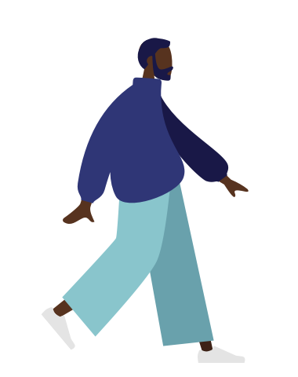
Risk Factors: HIV and forced displacement
People forcibly displace are often at increased risk of HIV, though these crises or emergencies do not always translate into an increase in infections.
Displacement exacerbate existing vulnerabilities and inequalities increasing the risk of HIV for some specific groups.
Refugees and displaced people are not usually included in national HIV strategies.
People living with, and affected by, HIV and AIDS are particularly vulnerable to the effects of instability and lack of access to treatment and prevention services

Slide 6
Meet Mario.
Age: 35
Country of origin: X
Transgender man
Living with HIV

Slide 7
Regional Protection Environment
In countries of origin
Chronic violence and insecurity as main cause of displacement.
Gender-based violence
Violence against LGBT people are driving hundreds to flee their countries.
During flight
Sexual abuse, trafficking, exploitation and violence against key groups: LGBTI, women, girls, youth.
Transactional sex compounded with increased unprotected sex.

Slide 8
Regional Protection Environment
In country of asylum/ origin (Internal displaced and deportees)
Health services are overwhelmed and this is affecting people who need care and treatment – especially those living with HIV.
Limited founding from Humanitarian actors for health related issues.
Refugees and migrants may avoid going to the hospital for fear of being discriminated due to their condition or being deported. That increases the risk of transmission in host countries.

Slide 9
HIV Sensitive Protection Responses
In the Venezuela situation, interagency efforts on promoting access to antiretroviral treatment for refugees living with HIV, regardless of their migratory status.
Across the region, UNHCR is providing technical support to national NGOs working in regional network (RSSN) to support people with HIV to safely contact clinics, hospitals, shelters and other organizations providing humanitarian assistance.
In NCA, UNHCR and its partners have develop an identification and referral system for people with specific needs.
In all Honduras and Mexico UNHCR has programs to prevent, respond and mitigate sexual violence and assistance to survivors, supporting SGBV mechanisms and services with communities, government and non-government actors.
AGD sensitive Protection Monitoring with essential health care referral system is in place in Panama and Guatemala.
Strategies to ensure protection and health access to LGBTI population have been strengthen in El Salvador.

